Slide 1



Database Management System-203105251
Shaikh Amin F., Assistant Professor
Computer Science & Engineering, PIET

Slide 2


UNIT-3
Storage strategies: Indices, B-trees, hashing.

Slide 3
Indices/Index in DBMS
Indexing is used to optimize the performance of a database by minimizing the number of disk accesses required when a query is processed.
The index is a type of data structure. It is used to locate and access the data in a database table quickly.

Slide 4
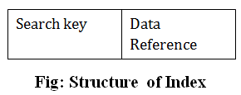
Indices/Index in DBMS
Indexing:

Slide 5
Indices/Index in DBMS
The first column of the database is the search key that contains a copy of the primary key or candidate key of the table. The values of the primary key are stored in sorted order so that the corresponding data can be accessed easily.
The second column of the database is the data reference. It contains a set of pointers holding the address of the disk block where the value of the particular key can be found.

Slide 6
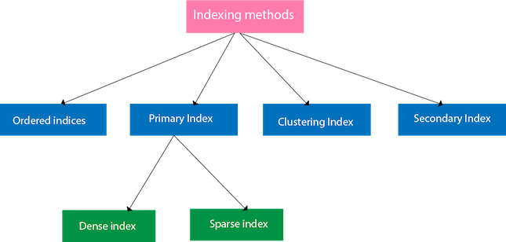
Indices/Index in DBMS

Slide 7
Ordered indices
The indices are usually sorted to make searching faster. The indices which are sorted are known as ordered indices.
Example: Suppose we have an employee table with thousands of record and each of which is 10 bytes long. If their IDs start with 1, 2, 3....and so on and we have to search student with ID-543.

Slide 8
Ordered indices
In such cases, In the case of a database with no index, we have to search the disk block from starting till it reaches 543. The DBMS will read the record after reading 543*10=5430 bytes.
In the case of an index, we will search using indexes and the DBMS will read the record after reading 542*2= 1084 bytes which are very less compared to the previous case.

Slide 9
Primary Index
If the index is created on the basis of the primary key of the table, then it is known as primary indexing. These primary keys are unique to each record and contain 1:1 relation between the records.
As primary keys are stored in sorted order, the performance of the searching operation is quite efficient.
The primary index can be classified into two
types: Dense index and Sparse index.
Primary Index1
Dense Index
Sparse Index

Slide 10
Primary Index
For Example:
Table: Student (enrollNo, Name, Address, City, MobileNo) [enrollNo is primary key]
Index: CREATE INDEX idx_StudentRno ON Student (enrollNo);
STUDENT:
SID | SNAME | DEPARTMENT | CONTACT_NO | EMAIL

Slide 11
Dense index
The dense index contains an index record for every search key value in the data file. It makes searching faster.
In this, the number of records in the index table is same as the number of records in the main table.
It needs more space to store index record itself. The index records have the search key and a pointer to the actual record on the disk.

Slide 12
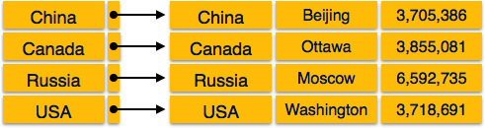
Dense index

Slide 13
Sparse index
In sparse index, index records are not created for every search key.
An index record here contains a search key and an actual pointer to the data on the disk.
To search a record, we first proceed by index record and reach at the actual location of the data. If the data we are looking for is not where we directly reach by following the index, then the system starts sequential search until the desired data is found.

Slide 14
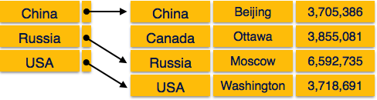
Sparse index

Slide 15
Secondary Index/Multilevel Index
Index records comprise search-key values and data pointers.
Multilevel index is stored on the disk along with the actual database files. As the size of the database grows, so does the size of the indices. There is an immense need to keep the index records in the main memory so as to speed up the search operations. If single-level index is used, then a large size index cannot be kept in memory which leads to multiple disk accesses.

Slide 16
Secondary Index/Multilevel Index
Multi-level Index helps in breaking down the index into several smaller indices in order to make the outermost level so small that it can be saved in a single disk block, which can easily be accommodated anywhere in the main memory.

Slide 17
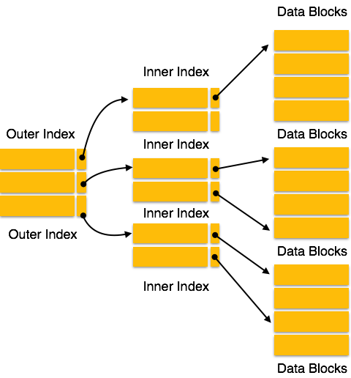
Secondary Index/Multilevel Index

Slide 18
Clustering Index
A Clustered index is one of the special types of index which reorders the way records in the table are physically stored on the disk. It sorts and stores the data rows in the table or view based on their key values. It is essentially a sorted copy of the data in the indexed columns.

Slide 19
Clustering Index
A Clustered index is one of the special types of index which reorders the way records in the table are physically stored on the disk. It sorts and stores the data rows in the table or view based on their key values. It is essentially a sorted copy of the data in the indexed columns.

Slide 20
Clustering Index
Dept | Name
CE | Nidhi
CE | Vikas
EE | Jay
EE | Mark
EC | Neel
EC | Derick
ME | John
ME | Ketan
CE
EE
EC
ME
Index Table
Main Table

Slide 21
B-Tree

Slide 22
B-Tree
B-tree is a data structure that store data in its node in sorted order. We can represent sample B-tree as follows.
B-tree stores data in such a way that each node contains keys in ascending order.
Each of these keys has two references to another two child nodes.
The left side child node keys are less than the current keys and the right side child node keys are greater than the current keys.
11
Root Node
Intermediary Node
3, 6
16, 20
Leaf Node
1,2
4,5
7,10
12, 13, 14
18, 19
24, 25

Slide 23
Searching a record in B-tree
Intermediary Node
11
Root Node
Suppose we want to search 18 in the above B tree structure.
First, we will fetch for the intermediary node which will direct to the leaf node that can contain a record for 18.
So, in the intermediary node, we will find a branch between 16 and 20 nodes.
Then at the end, we will be redirected to the fifth leaf node. Here DBMS will perform a sequential search to find 18.
3, 6
16, 20
Leaf Node
1,2
4,5
7,10
12, 13, 14
18, 19
24, 25

Slide 24
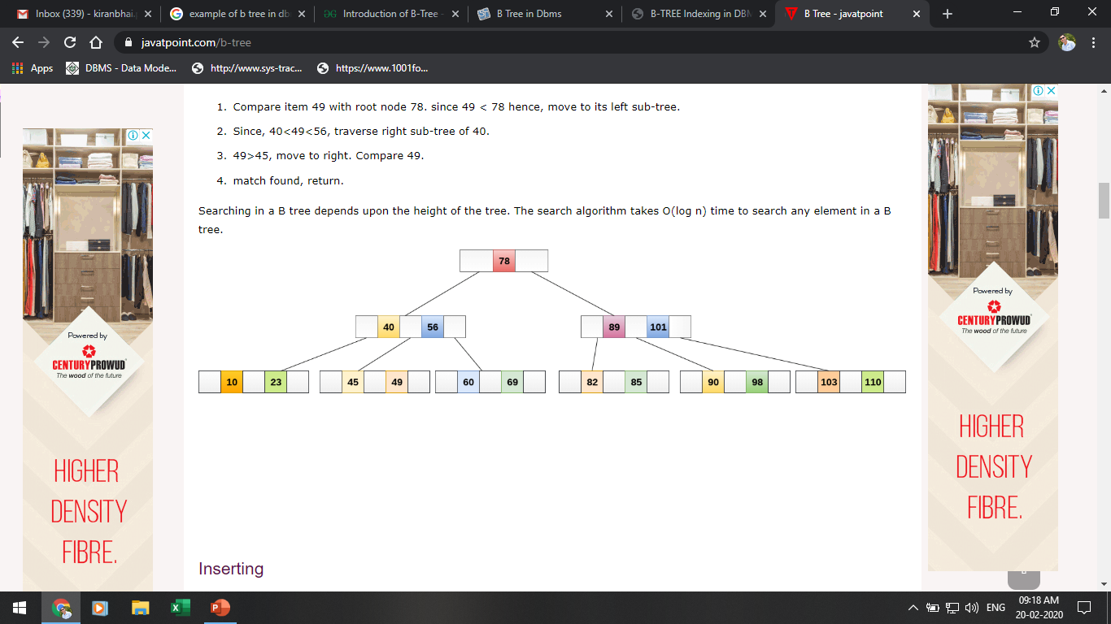
Searching In B-Tree
If we search for an item 49 in the following B Tree. The process will something like following :
Compare item 49 with root node 78. since 49 < 78 hence, move to its left sub-tree.
Since, 40<49<56, traverse right sub-tree of 40.
49>45, move to right. Compare 49.
match found, return.
Searching in a B tree depends upon the height of the tree. The search algorithm takes O(log n) time to search any element in a B tree

Slide 25
Searching In B-Tree
If we search for an item 49 in the following B Tree. The process will something like following :
Compare item 49 with root node 78. since 49 < 78 hence, move to its left sub-tree.
Since, 40<49<56, traverse right sub-tree of 40.
49>45, move to right. Compare 49.
match found, return.
Searching in a B tree depends upon the height of the tree. The search algorithm takes O(log n) time to search any element in a B tree

Slide 26
Inserting a record In B-Tree
Insertions are done at the leaf node level. The following algorithm needs to be followed in order to insert an item into B Tree.
Traverse the B Tree in order to find the appropriate leaf node at which the node can be inserted.
If the leaf node contain less than m-1 keys then insert the element in the increasing order.
Else, if the leaf node contains m-1 keys, then follow the following steps.
Insert the new element in the increasing order of elements.
Split the node into the two nodes at the median.
Push the median element upto its parent node.
If the parent node also contain m-1 number of keys, then split it too by following the same steps.

Slide 27
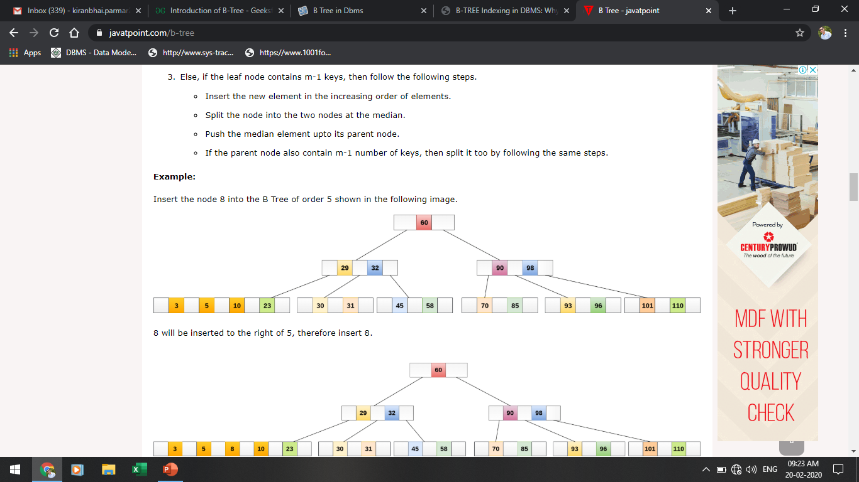
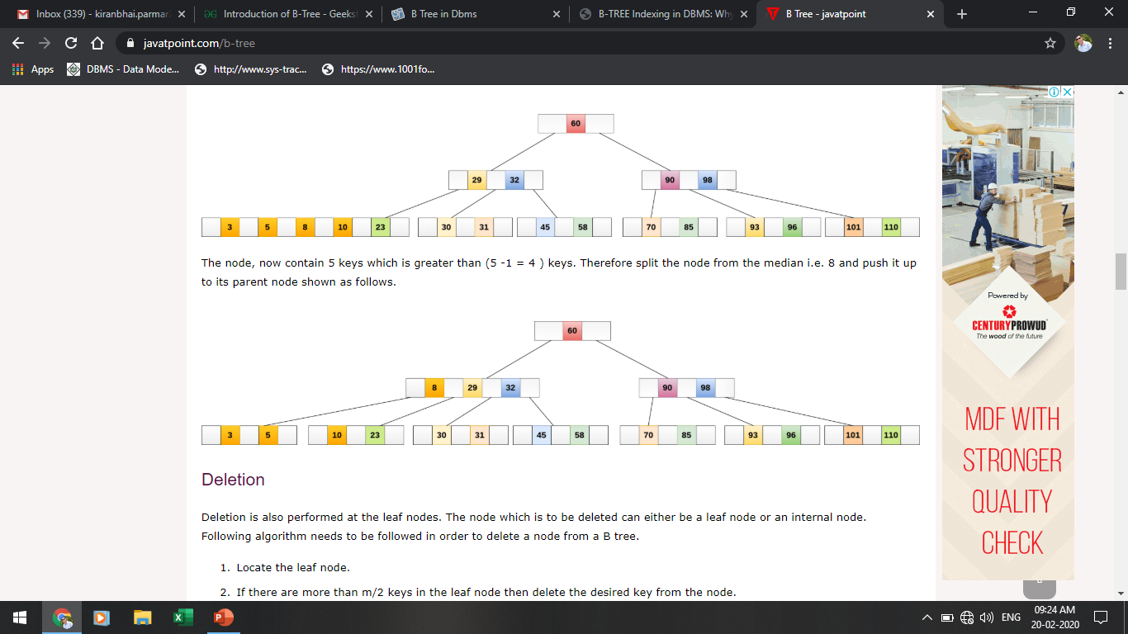
Inserting a record In B-Tree
Insert the node 8 into the B Tree of order 5 shown in the following image.
8 will be inserted to the right of 5, therefore insert 8.

Slide 28
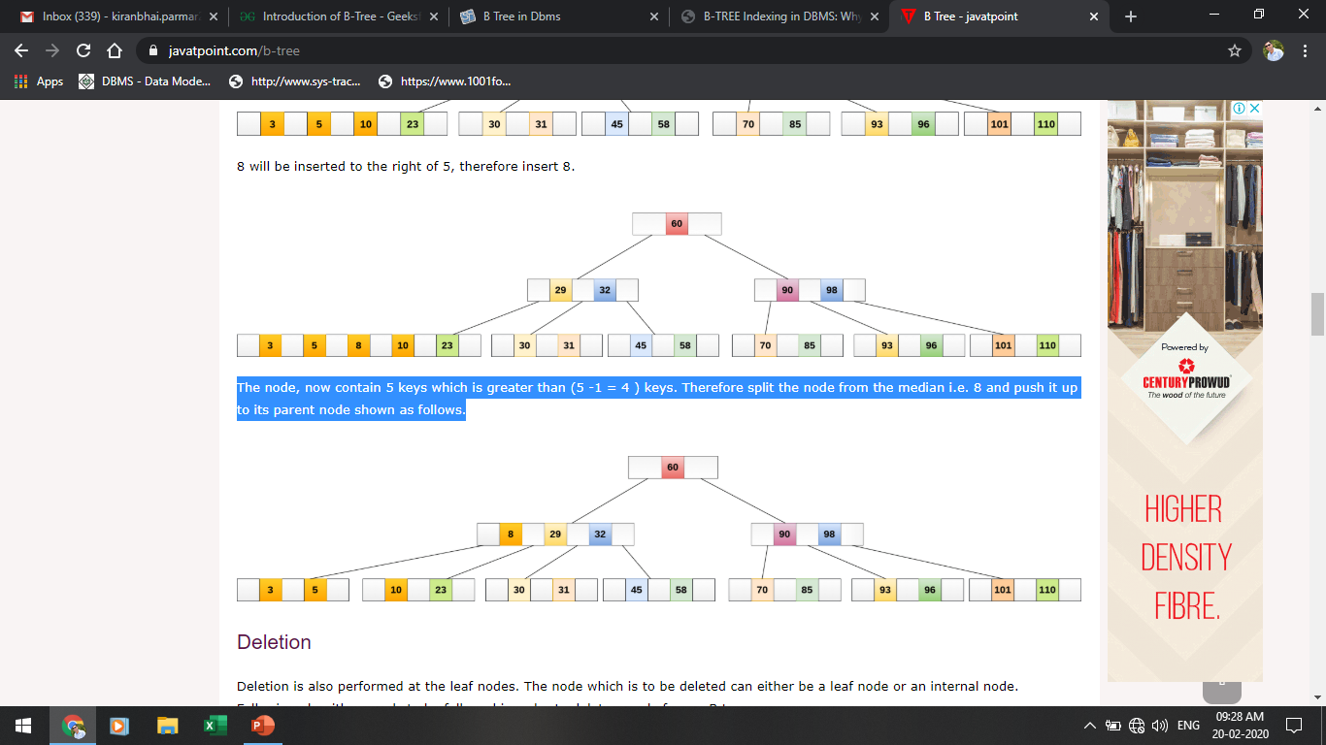
Inserting a record In B-Tree
The node, now contain 5 keys which is greater than (5 -1 = 4 ) keys. Therefore split the node from the median i.e. 8 and push it up to its parent node shown as follows.

Slide 29
Advantages & Disadvantages Of B-Tree Indices
Advantages of B-Tree indices:
May use less tree nodes than a corresponding B⁺-Tree.
Sometimes possible to find search-key value before reaching leaf node.
Disadvantages of B-Tree indices:
Only small fraction of all search-key values are found early
Non-leaf nodes are larger, so fan-out is reduced. Thus, B-Trees typically have greater depth than corresponding B⁺-Tree
Insertion and deletion more complicated than in B⁺-Trees
Implementation is harder than B⁺-Trees.

Slide 30
Hashing

Slide 31
Hashing
In DBMS, hashing is a technique to directly search the location of desired data on the disk without using index structure.
Hashing method is used to index and retrieve items in a database as it is faster to search that specific item using the shorter hashed key instead of using its original value.
Data is stored in the form of data blocks whose address is generated by applying a hash function in the memory location where these records are stored known as a data.

Slide 32
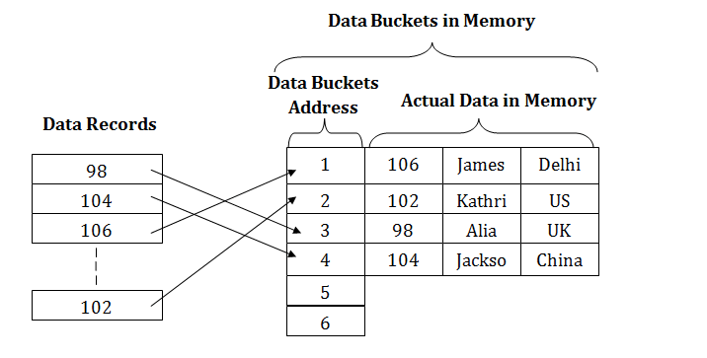
Hashing

Slide 33
Why do we need Hashing?
For a huge database structure, it's tough to search all the index values through all its level and then you need to reach the destination data block to get the desired data.
Hashing method is used to index and retrieve items in a database as it is faster to search that specific item using the shorter hashed key instead of using its original value.

Slide 34
Why do we need Hashing?
Hashing is an ideal method to calculate the direct location of a data record on the disk without using index structure.
It is also a helpful technique for implementing dictionaries.

Slide 35
Important Terminologies using in Hashing
Data bucket – Data buckets are memory locations where the records are stored. It is also known as Unit Of Storage.
Key: A DBMS key is an attribute or set of an attribute which helps you to identify a row(tuple) in a relation(table). This allows you to find the relationship between two tables.
Hash function: A hash function, is a mapping function which maps all the set of search keys to the address where actual records are placed.

Slide 36
Important Terminologies using in Hashing
Linear Probing – Linear probing is a fixed interval between probes. In this method, the next available data block is used to enter the new record, instead of overwriting on the older record.
Quadratic probing- It helps you to determine the new bucket address. It helps you to add Interval between probes by adding the consecutive output of quadratic polynomial to starting value given by the original computation.

Slide 37
Important Terminologies using in Hashing
Hash index – It is an address of the data block. A hash function could be a simple mathematical function to even a complex mathematical function.
Double Hashing –Double hashing is a computer programming method used in hash tables to resolve the issues of has a collision.
Bucket Overflow: The condition of bucket-overflow is called collision. This is a fatal stage for any static has to function.

Slide 38
What is collision
Hash collision is a state when the resultant hashes from two or more data in the data set, wrongly map the same place in the hash table.
How to deal with Hashing Collision?
Rehashing: This method, invokes a secondary hash function, which is applied continuously until an empty slot is found, where a record should be placed.

Slide 39
What is collision
Chaining: Chaining method builds a Linked list of items whose key hashes to the same value. This method requires an extra link field to each table position.

Slide 40
Types of SQL hashing methods:
Static Hashing
Dynamic Hashing
Static Hashing
In the static hashing, the resultant data bucket address will always remain the same.
Therefore, if you generate an address for say Student_ID = 10 using hashing function mod(3), the resultant bucket address will always be 1. So, you will not see any change in the bucket address.

Slide 41
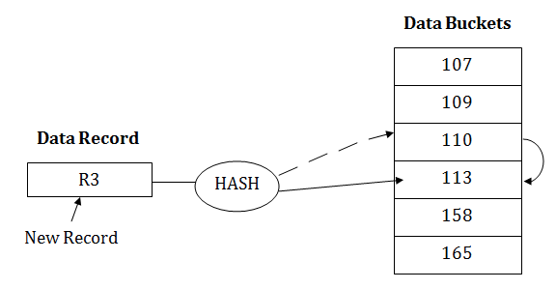
Types of SQL hashing methods:

Slide 42
Types of SQL hashing methods:
Static Hash Functions
Inserting a record: When a new record requires to be inserted into the table, you can generate an address for the new record using its hash key. When the address is generated, the record is automatically stored in that location.

Slide 43
Types of SQL hashing methods:
Static Hash Functions
Searching: When you need to retrieve the record, the same hash function should be helpful to retrieve the address of the bucket where data should be stored.
Delete a record: Using the hash function, you can first fetch the record which is you wants to delete. Then you can remove the records for that address in memory.

Slide 44
Types of SQL hashing methods:
Static hashing is further divided into
Open hashing
Close hashing.

Slide 45
Types of SQL hashing methods:
Open Hashing
In Open hashing method, Instead of overwriting older one the next available data block is used to enter the new record, This method is also known as linear probing.
For example, A2 is a new record which you wants to insert. The hash function generates address as 222. But it is already occupied by some other value. That's why the system looks for the next data bucket 501 and assigns A2 to it.

Slide 46
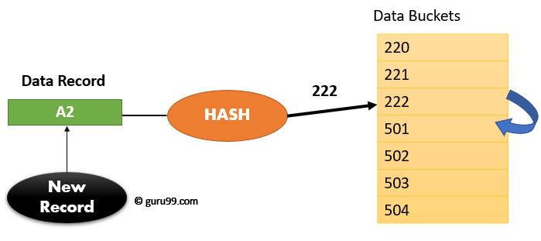
Types of SQL hashing methods:

Slide 47
Types of SQL hashing methods:
Close Hashing
In the close hashing method, when buckets are full, a new bucket is allocated for the same hash and result are linked after the previous.
For example: Suppose R3 is a new address which needs to be inserted into the table, the hash function generates address as 110 for it. But this bucket is full to store the new data. In this case, a new bucket is inserted at the end of 110 buckets and is linked to it.

Slide 48
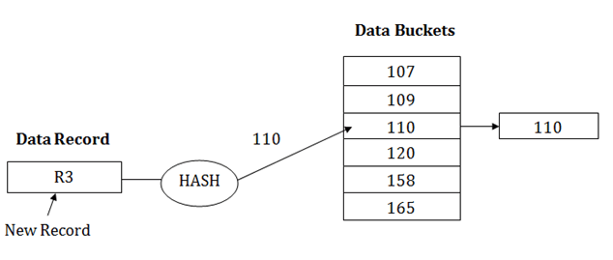
Types of SQL hashing methods:

Slide 49
Dynamic Hashing
The dynamic hashing method is used to overcome the problems of static hashing like bucket overflow.
In this method, data buckets grow or shrink as the records increases or decreases. This method is also known as Extendable hashing method.
This method makes hashing dynamic, i.e., it allows insertion or deletion without resulting in poor performance.

Slide 50
Dynamic Hashing
How to insert a new record?
Firstly, you have to follow the same procedure for retrieval, ending up in some bucket.
If there is still space in that bucket, then place the record in it.
If the bucket is full, then we will split the bucket and redistribute the records.

Slide 51
For Example
Consider the following grouping of keys into buckets, depending on the prefix of their hash address
Data Buckets
Key | Hash Address
1 | 11010
2 | 00000
3 | 11110
4 | 00000
5 | 01001
6 | 10101
7 | 10111
Data Records
2 4
B₀
00
01
5 6
B₁
10
11
1 3
B₂
7
B₃
The last two bits of 2 and 4 are 00. So it will go into bucket B0. The last two bits of 5 and 6 are 01, so it will go into bucket B1. The last two bits of 1 and 3 are 10, so it will go into bucket B2. The last two bits of 7 are 11, so it will go into B3.

Slide 52
Advantages Dynamic Hashing
Advantages of dynamic hashing
In this method, the performance does not decrease as the data grows in the system. It simply increases the size of memory to accommodate the data.
In this method, memory is well utilized as it grows and shrinks with the data. There will not be any unused memory lying.
This method is good for the dynamic database where data grows and shrinks frequently.

Slide 53
Disadvantages Dynamic Hashing
Disadvantages of dynamic hashing
In this method, if the data size increases then the bucket size is also increased. These addresses of data will be maintained in the bucket address table. This is because the data address will keep changing as buckets grow and shrink. If there is a huge increase in data, maintaining the bucket address table becomes tedious.
In this case, the bucket overflow situation will also occur. But it might take little time to reach this situation than static hashing.

Slide 54
Advantages & Disadvantages
Disadvantages of dynamic hashing

Slide 55


www.paruluniversity.ac.in

